Slide 1

Variable and Chart Types
Ashwin Malshe

Slide 2
Variable Types for Plotting
Discrete Variables Discrete variables can typically have only a finite number of values.
E.g., Names of publicly listed companies, names of industries, product categories, etc.
Continuous Variables Continuous variables in theory can have an infinite number of values.
E.g., Product sales, an individual’s wealth, daily temperature, etc.

Slide 3
Typical Plots for Discrete Variables

Slide 4
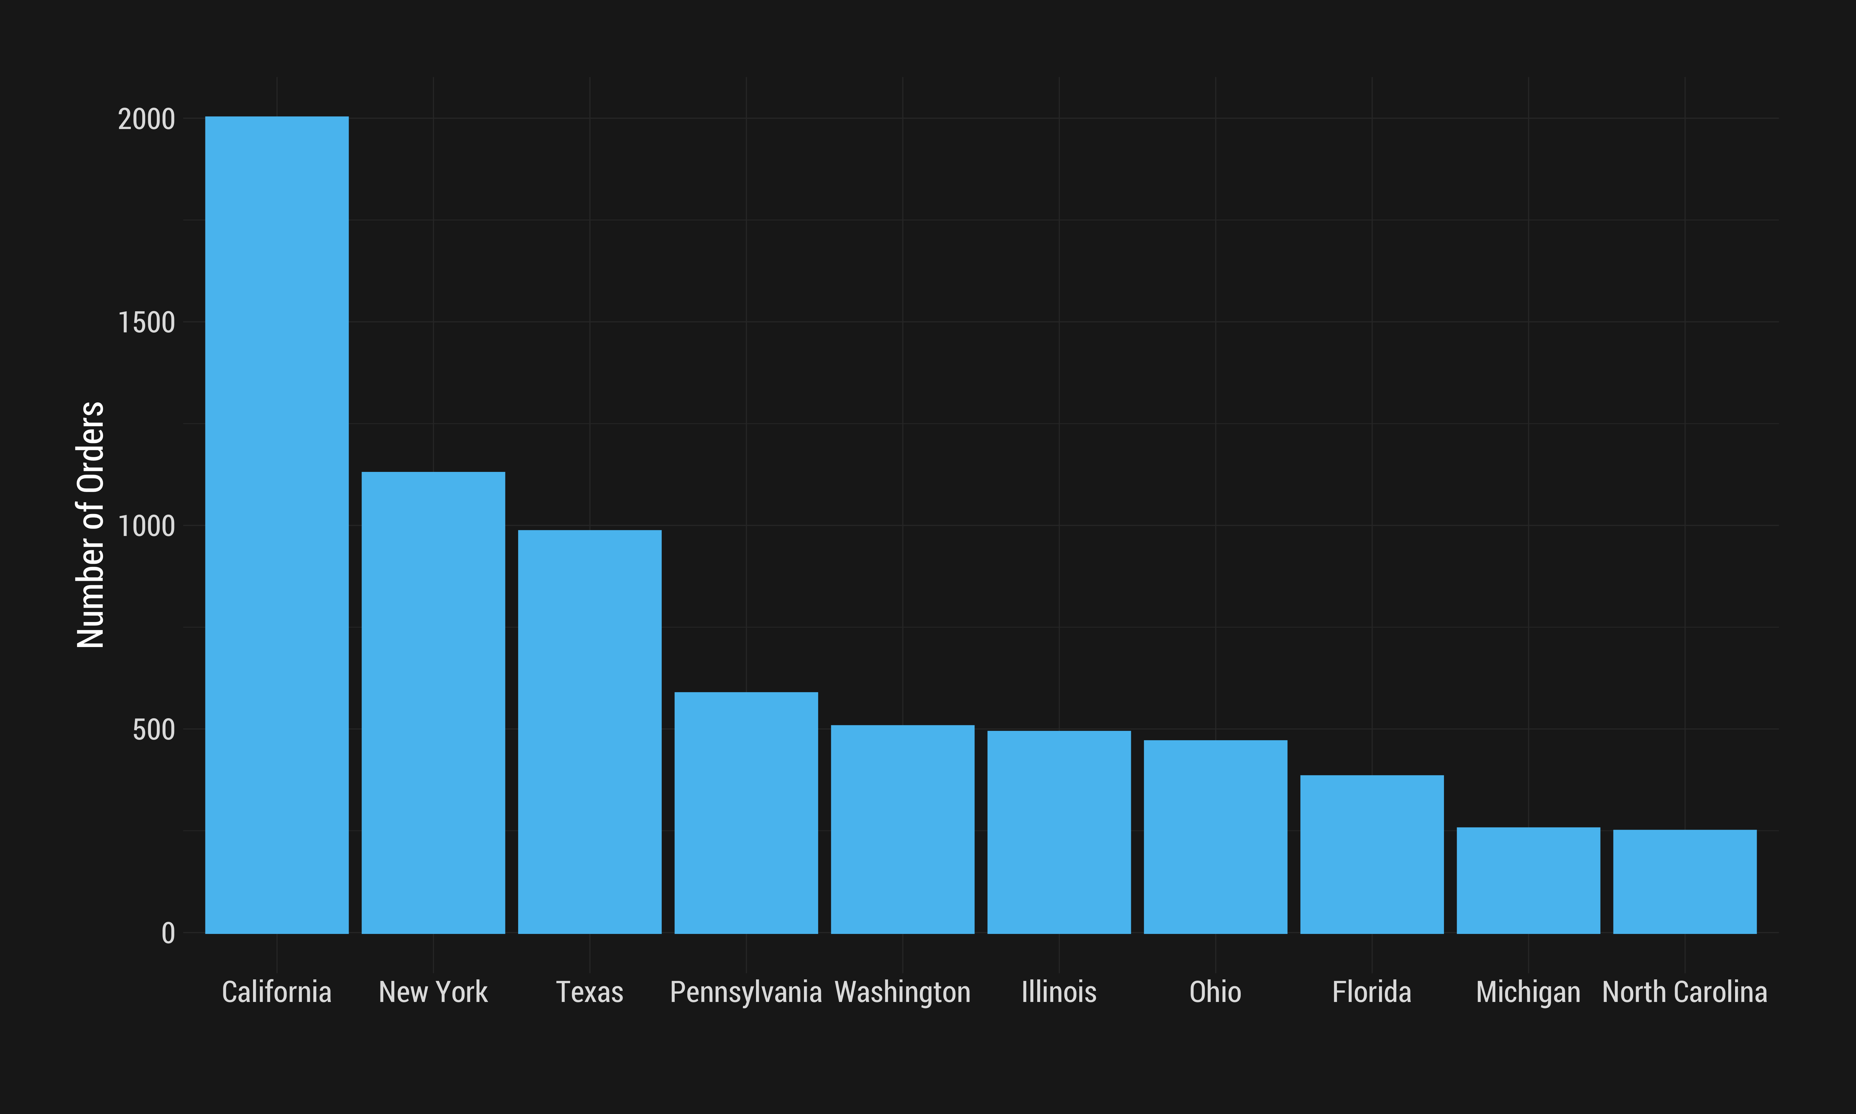
Bar Graph of Top 10 States by Total Number of Orders

Slide 5
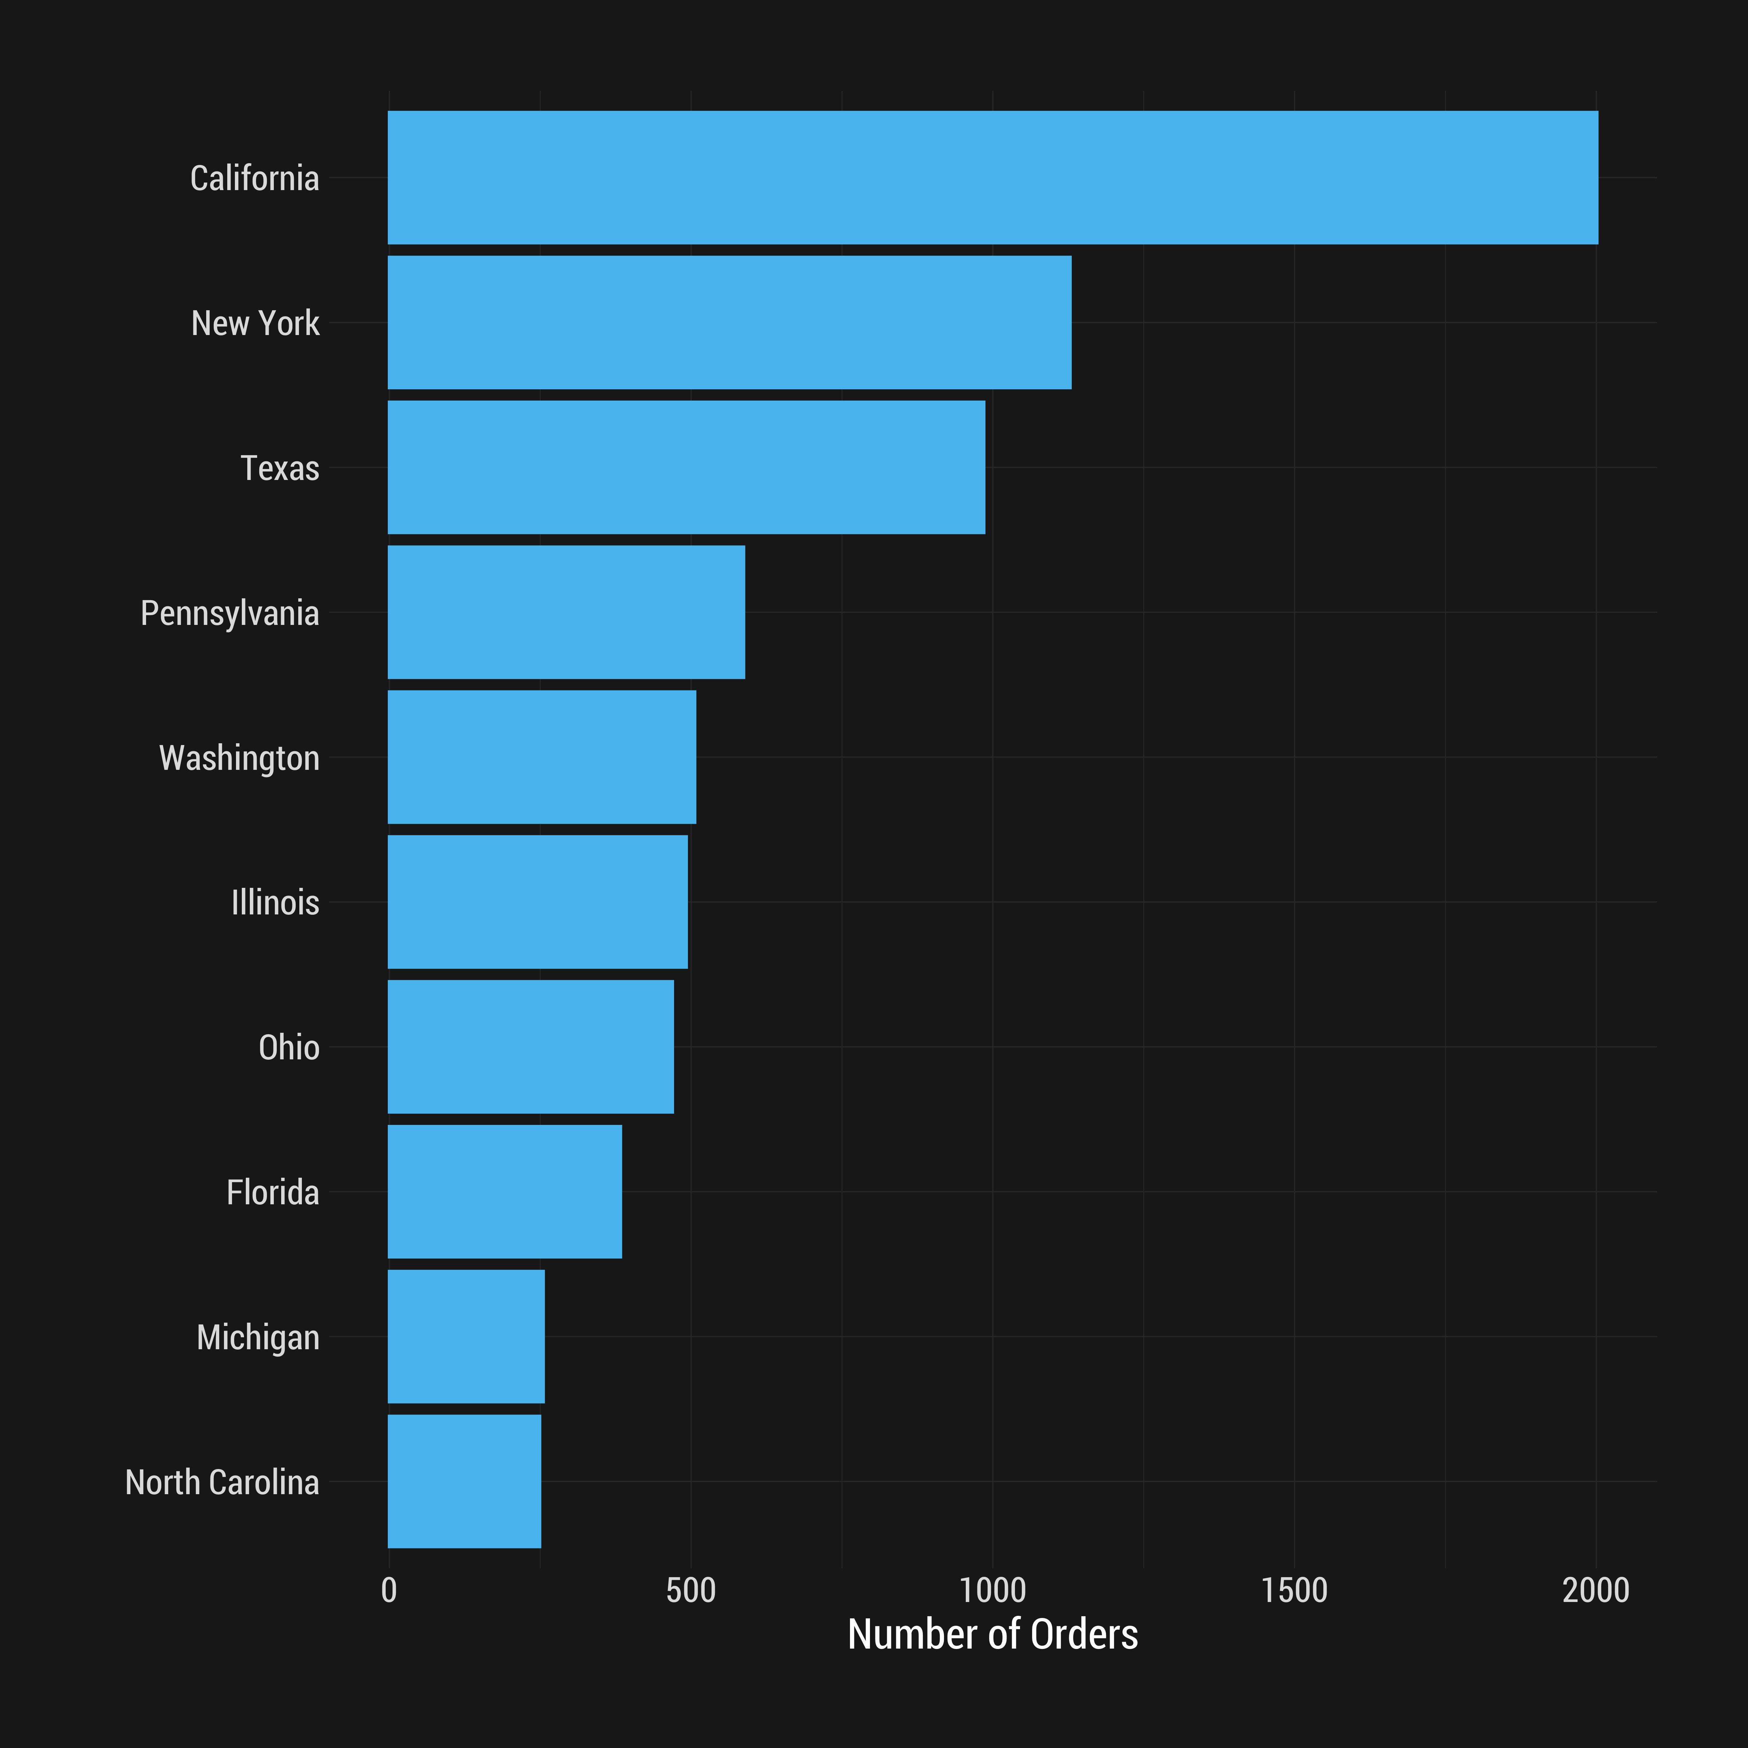
Flipped Bar Graph of Top 10 States by Total Number of Orders

Slide 6
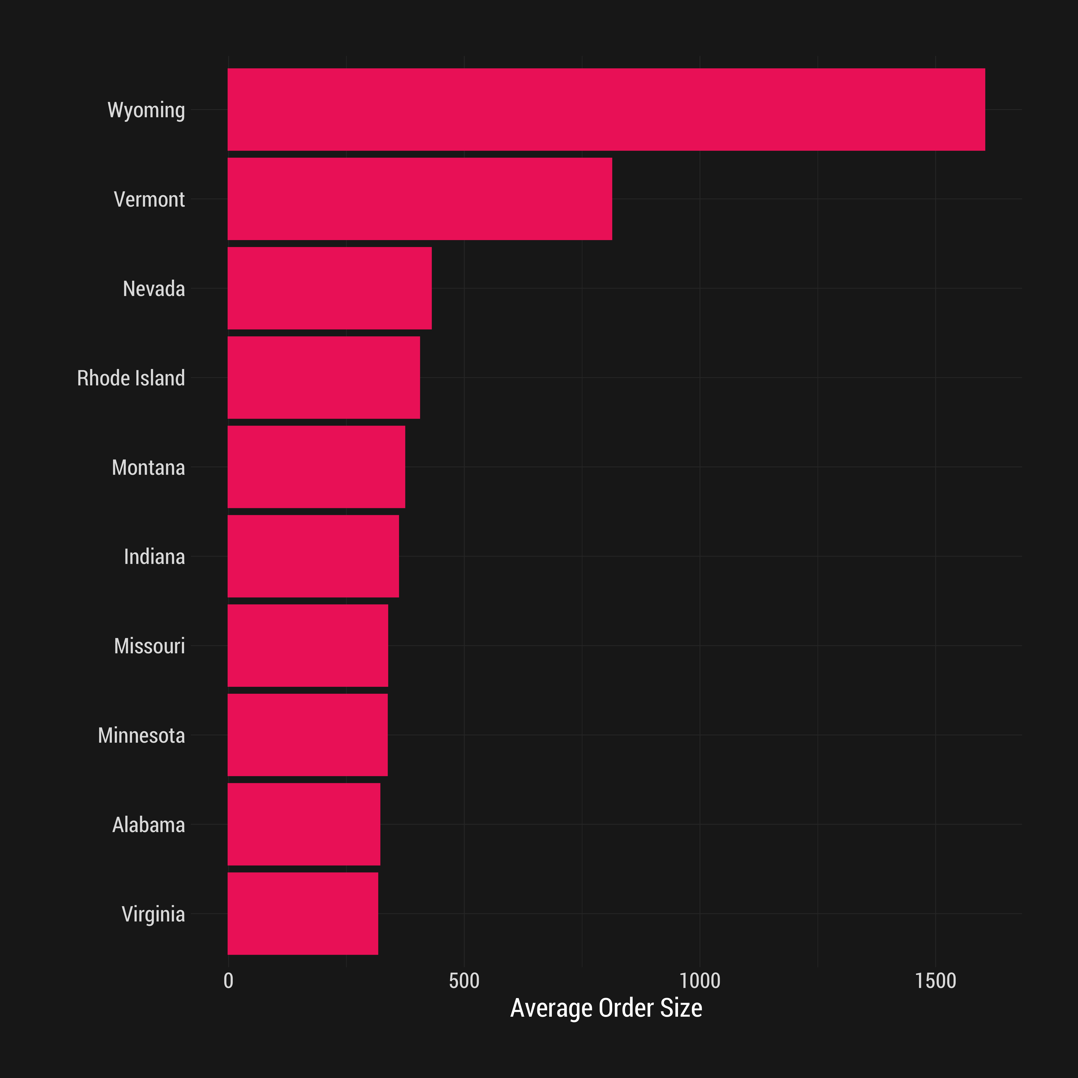
Flipped Bar Graph of Top 10 States by Average Order Size

Slide 7
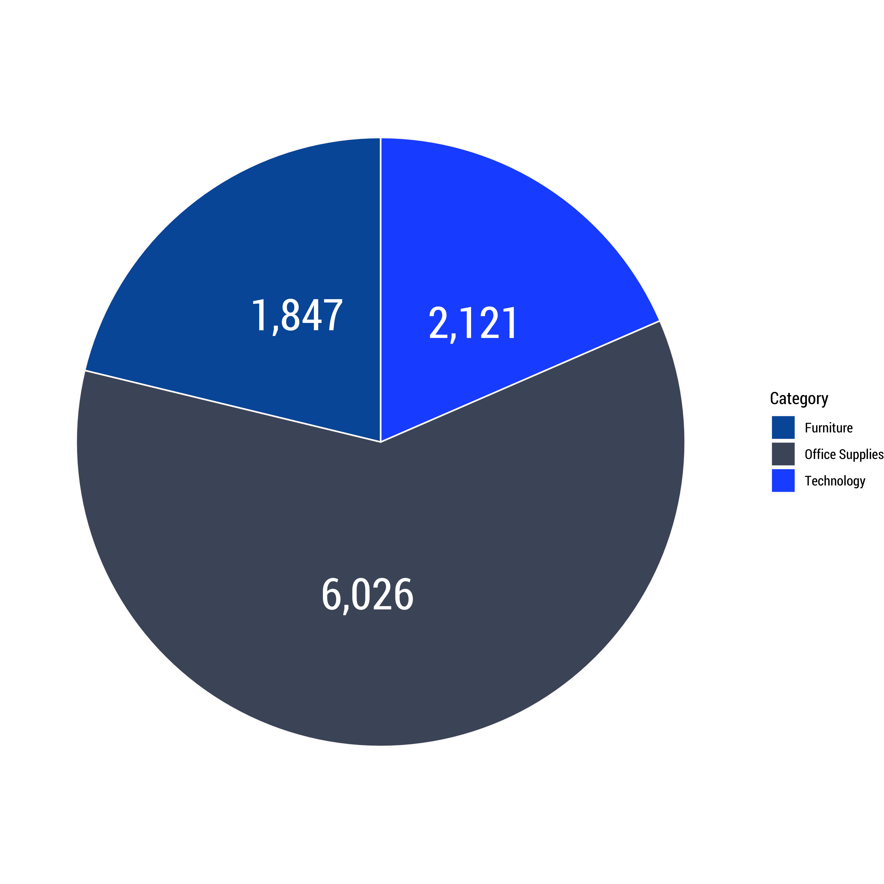
Pie Chart of Product Categories

Slide 8
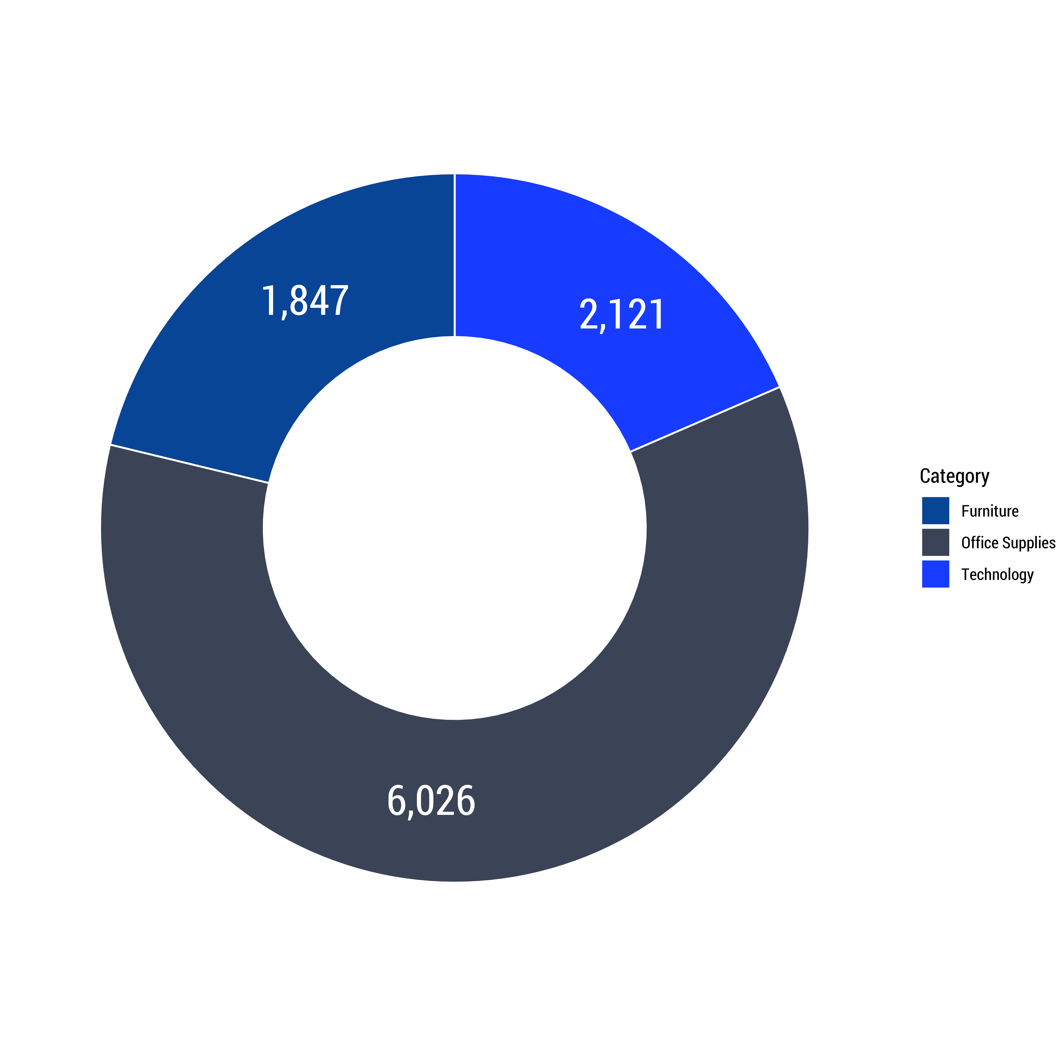
Donut Chart of Product Categories

Slide 9
Typical Plots for Continuous Variables

Slide 10
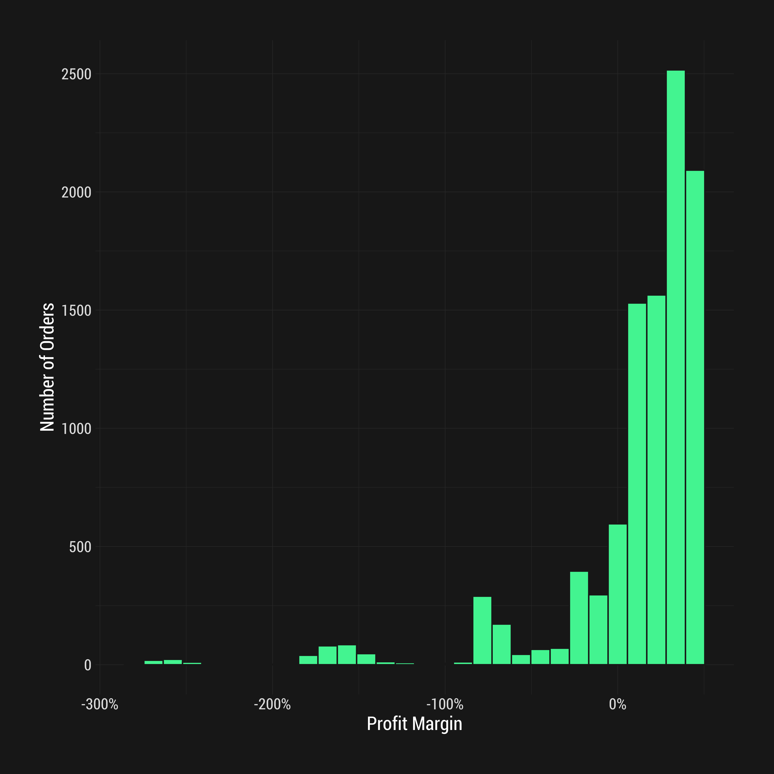
Histogram (30 bins) of Profit Margins

Slide 11
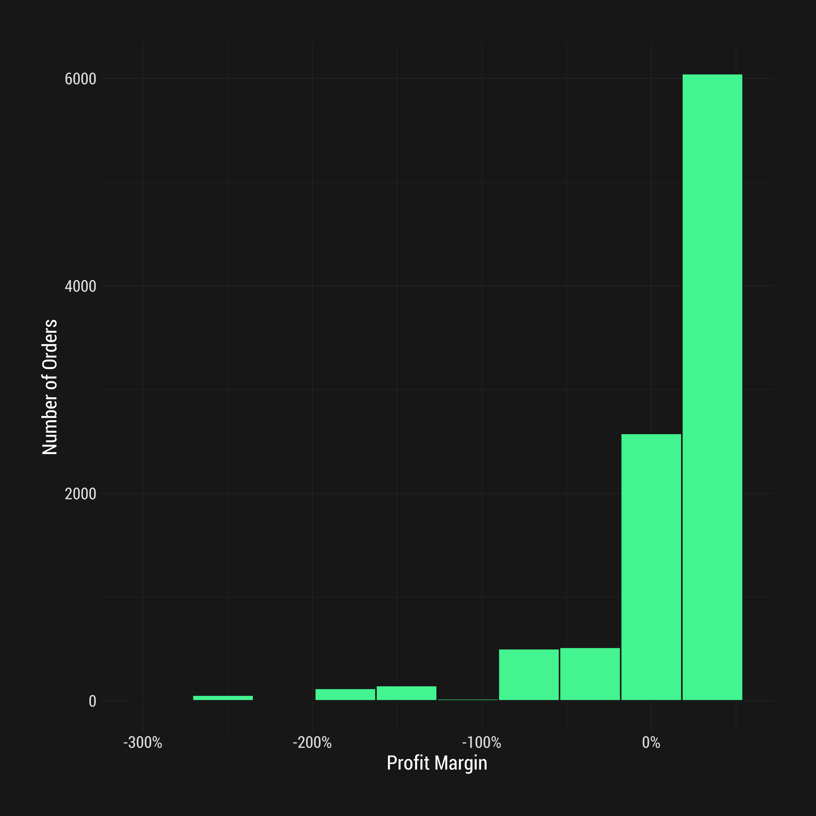
Histogram (10 bins) of Profit Margins

Slide 12
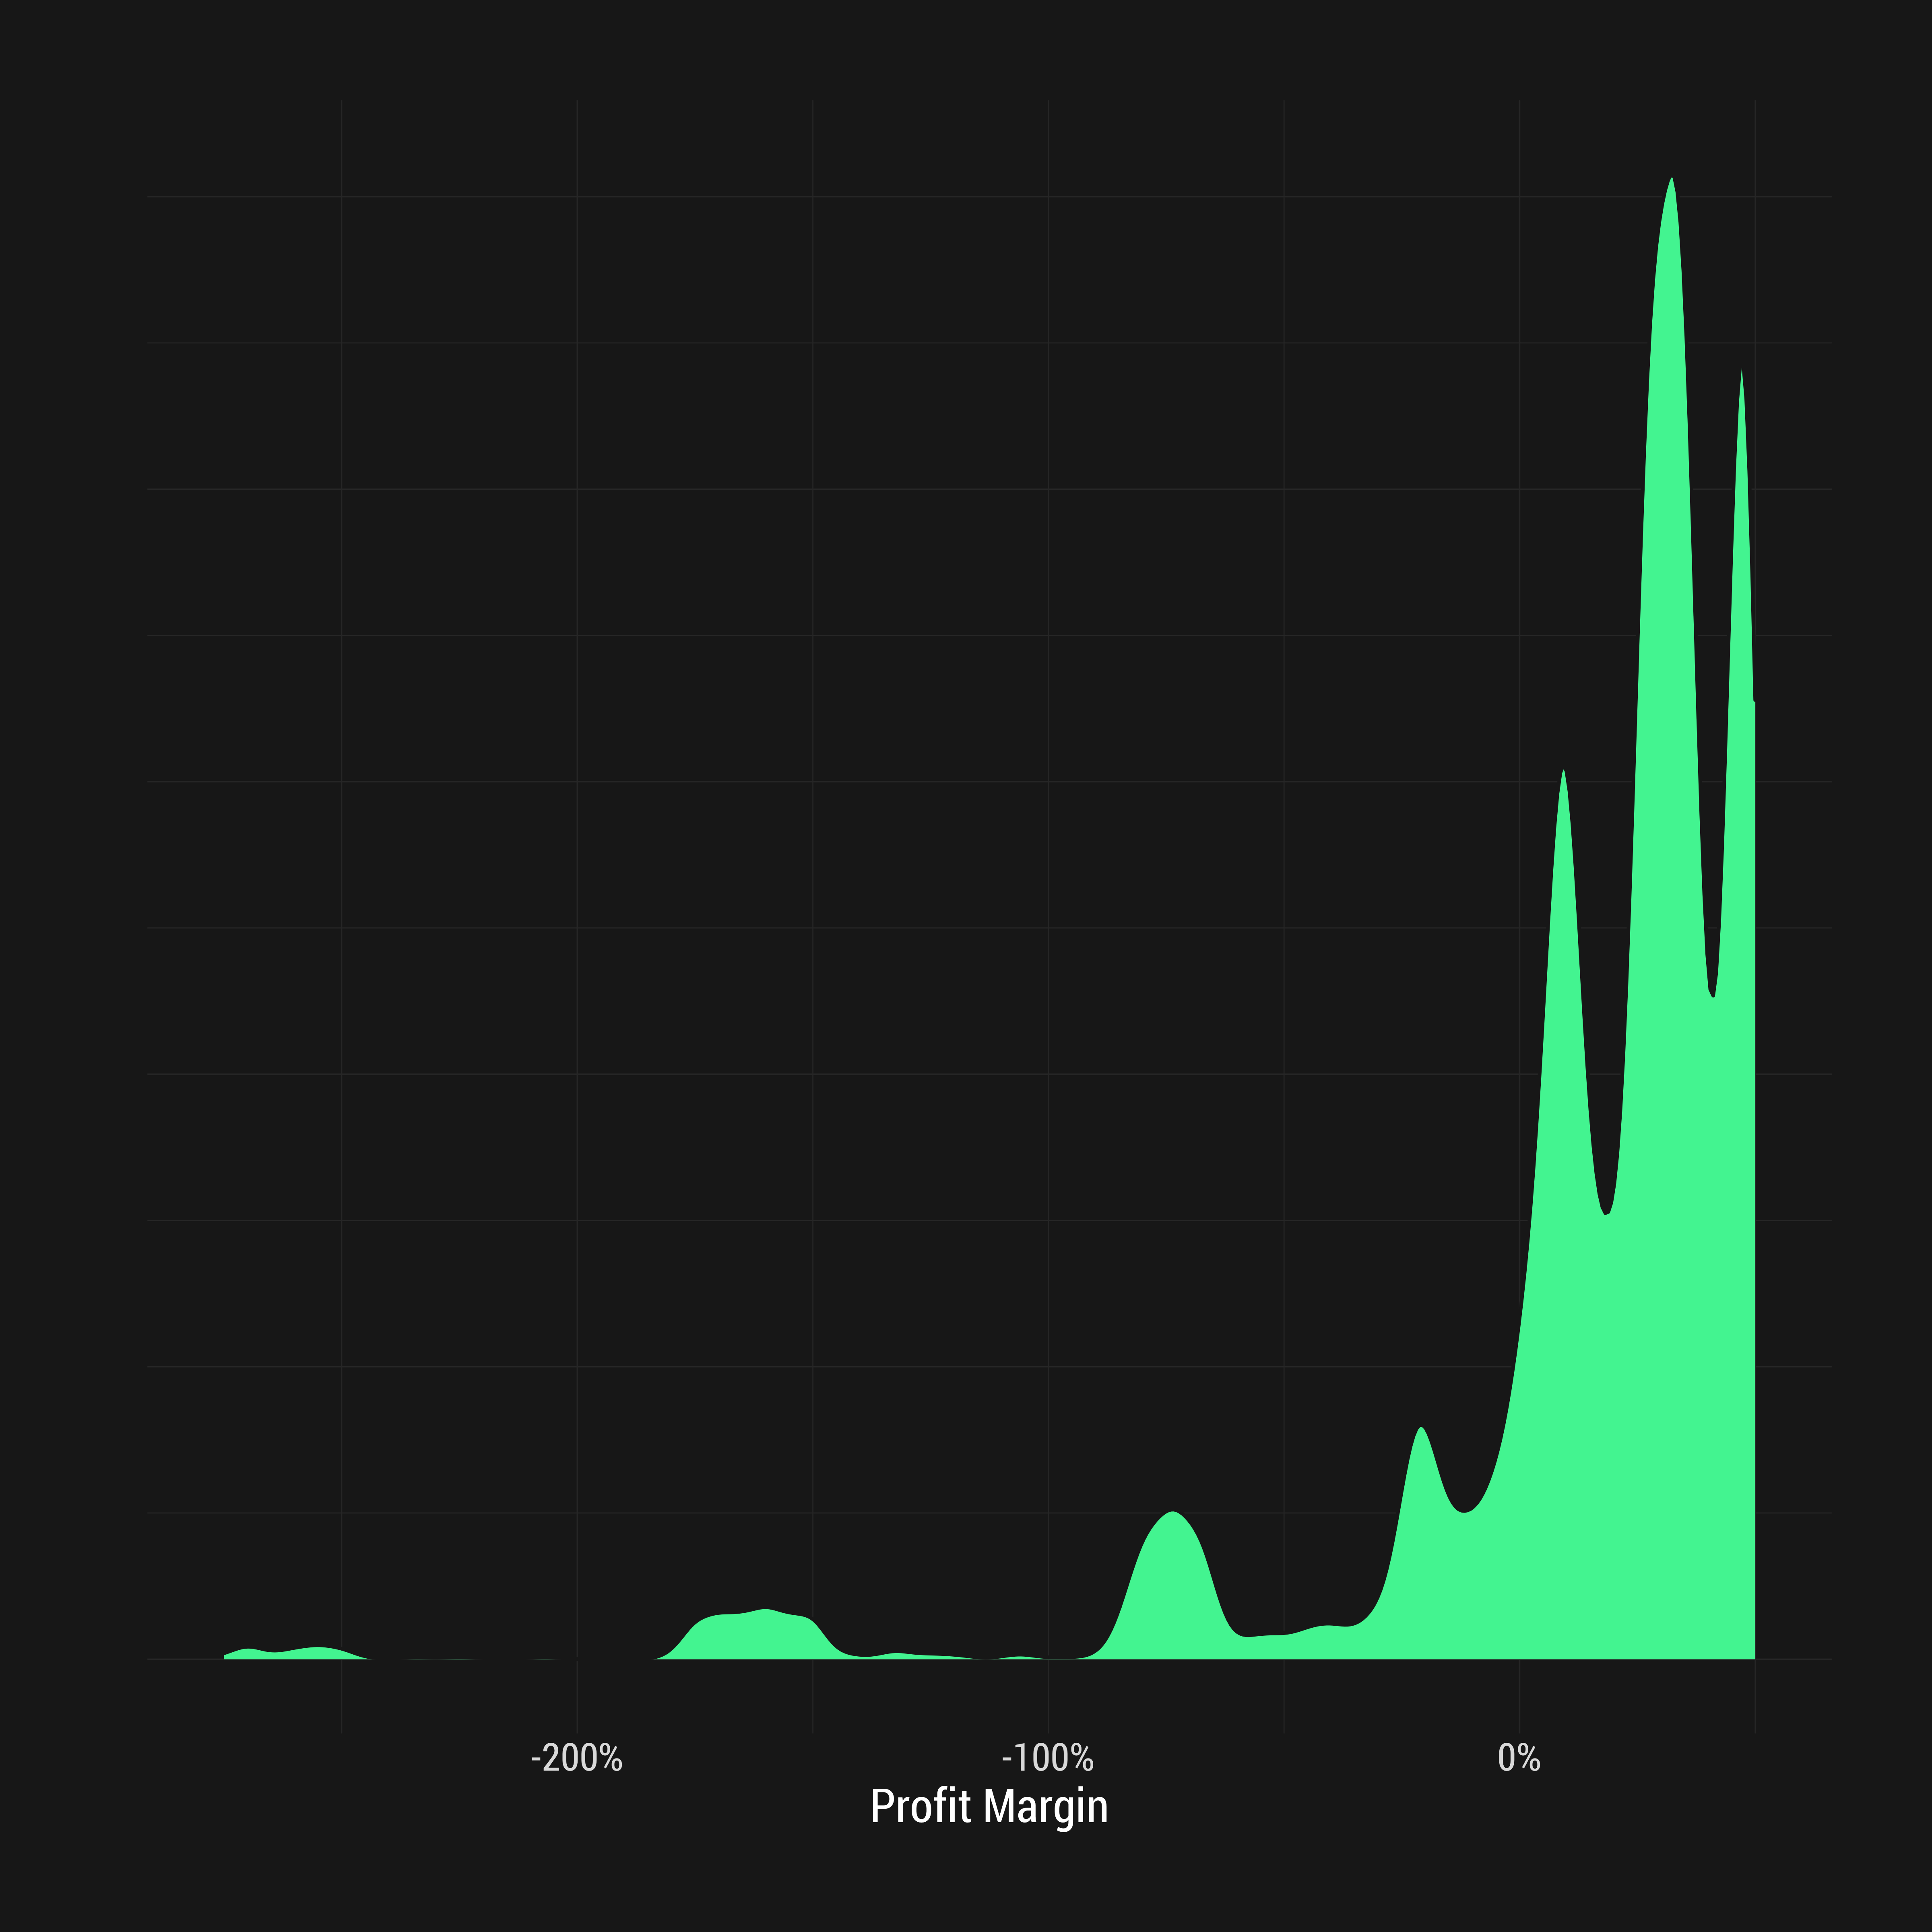
Histogram and Density Plot of Profit Margins

Slide 13
Typical Plots for Bivariate Relationships

Slide 14
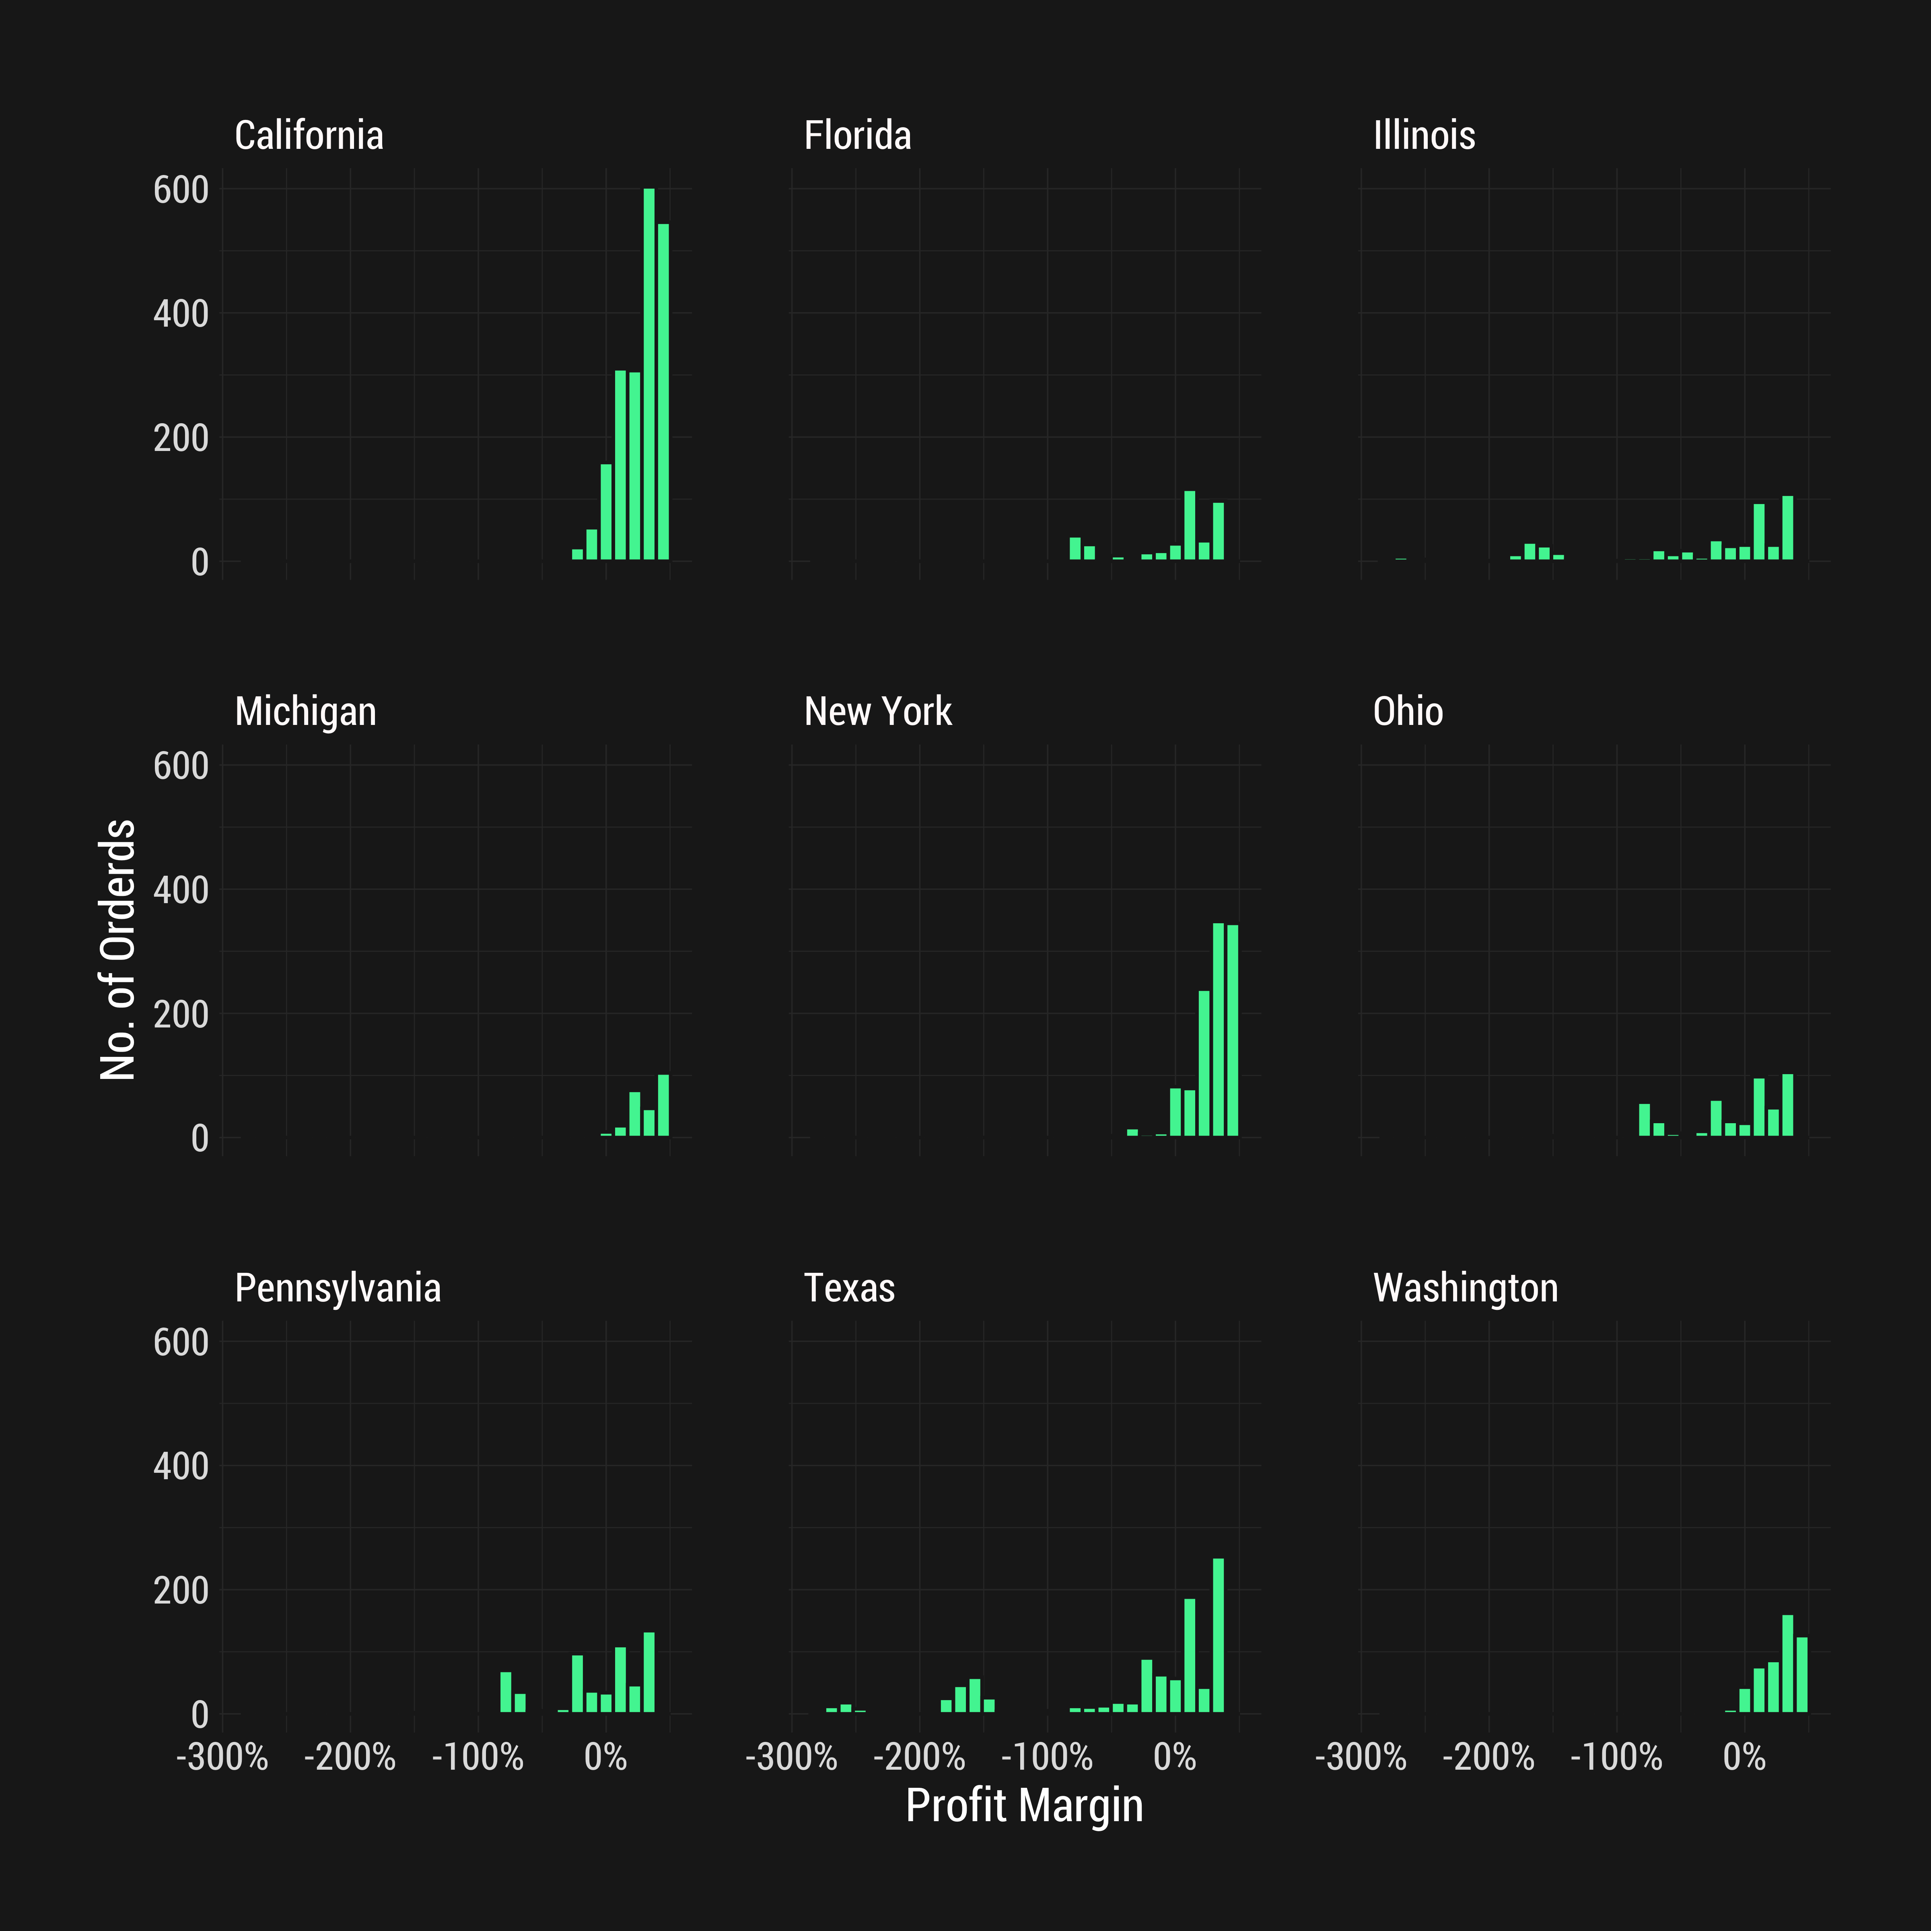
Facet Plot of Histograms of Profit Margin (Top 9 States by Orders)

Slide 15
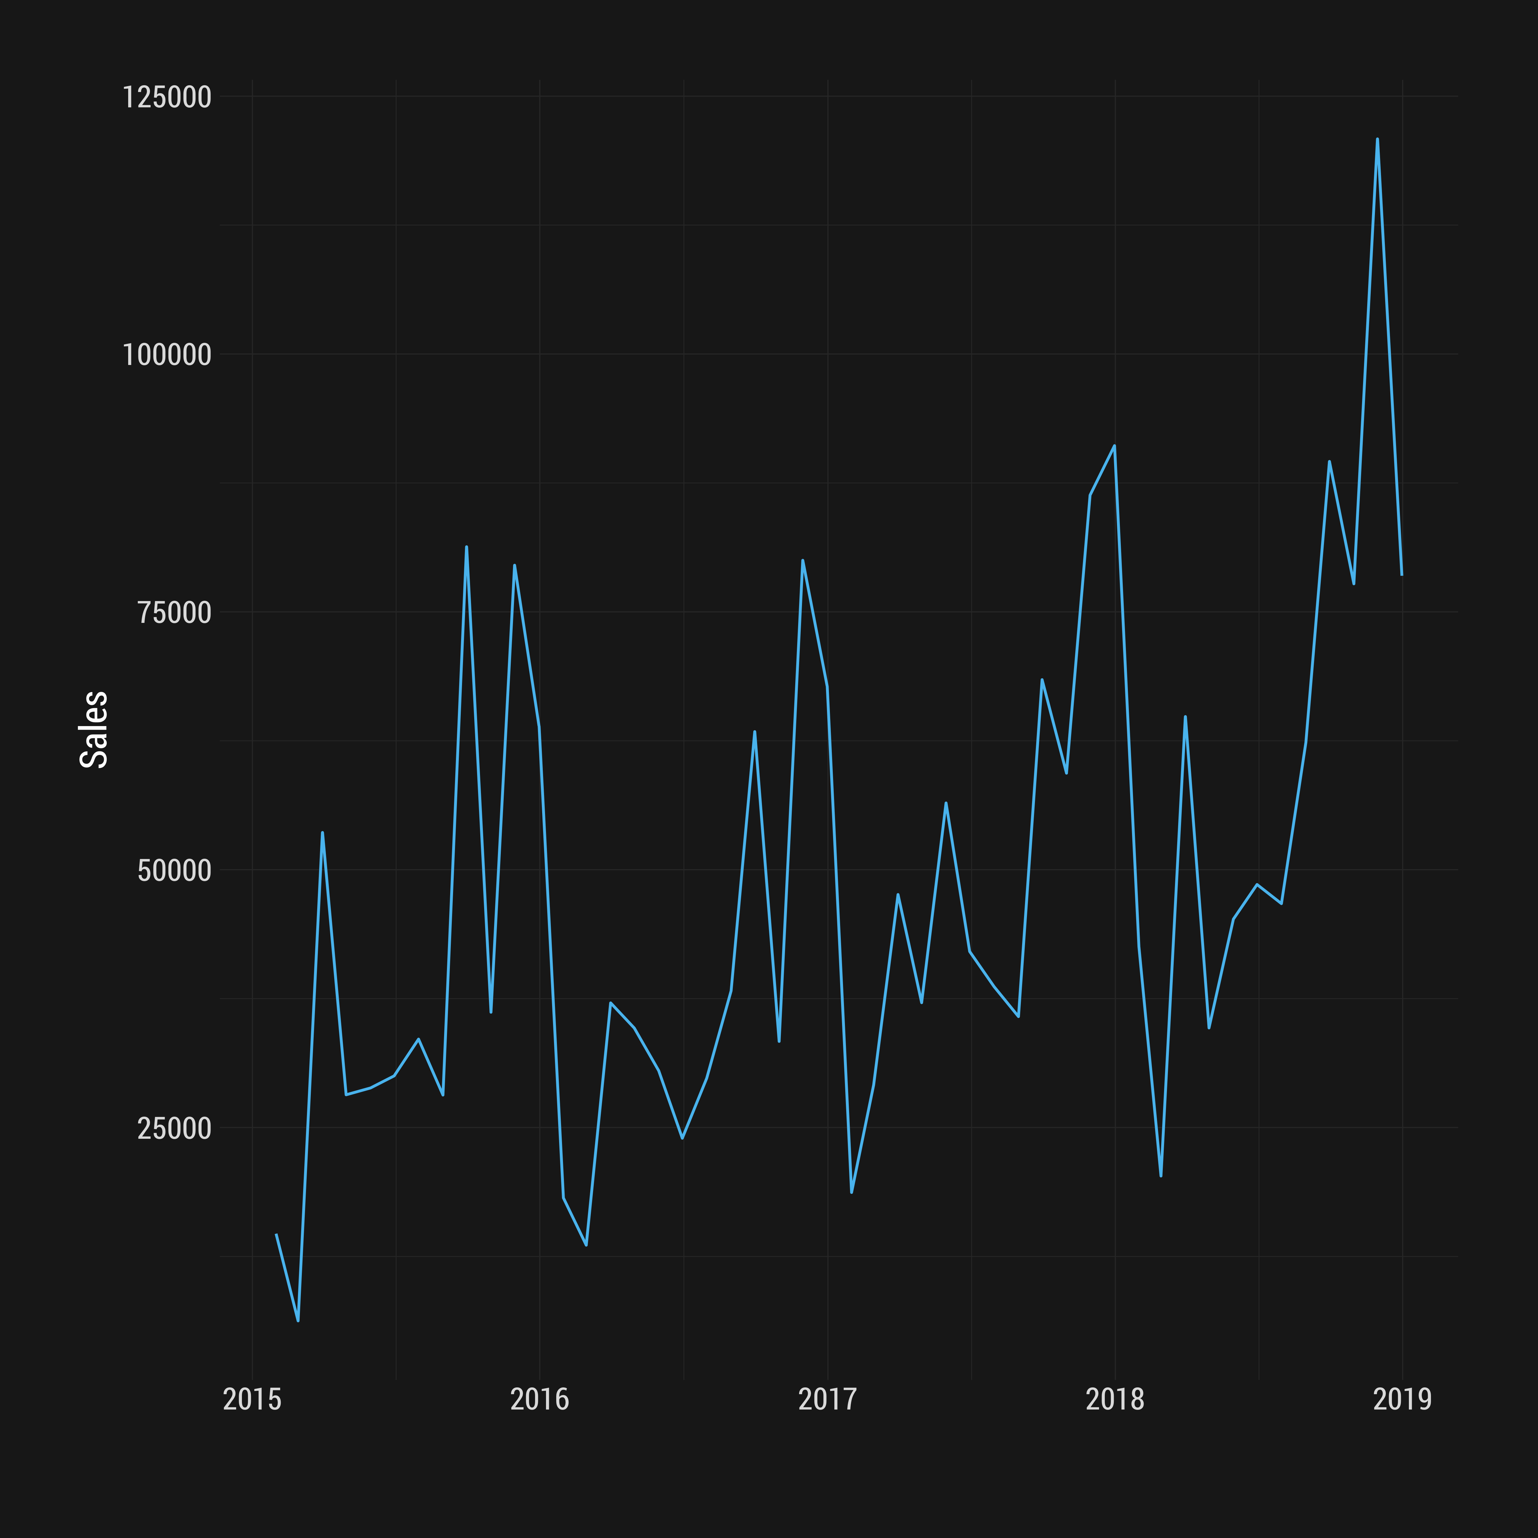
Line Graph of Total Monthly Sales

Slide 16
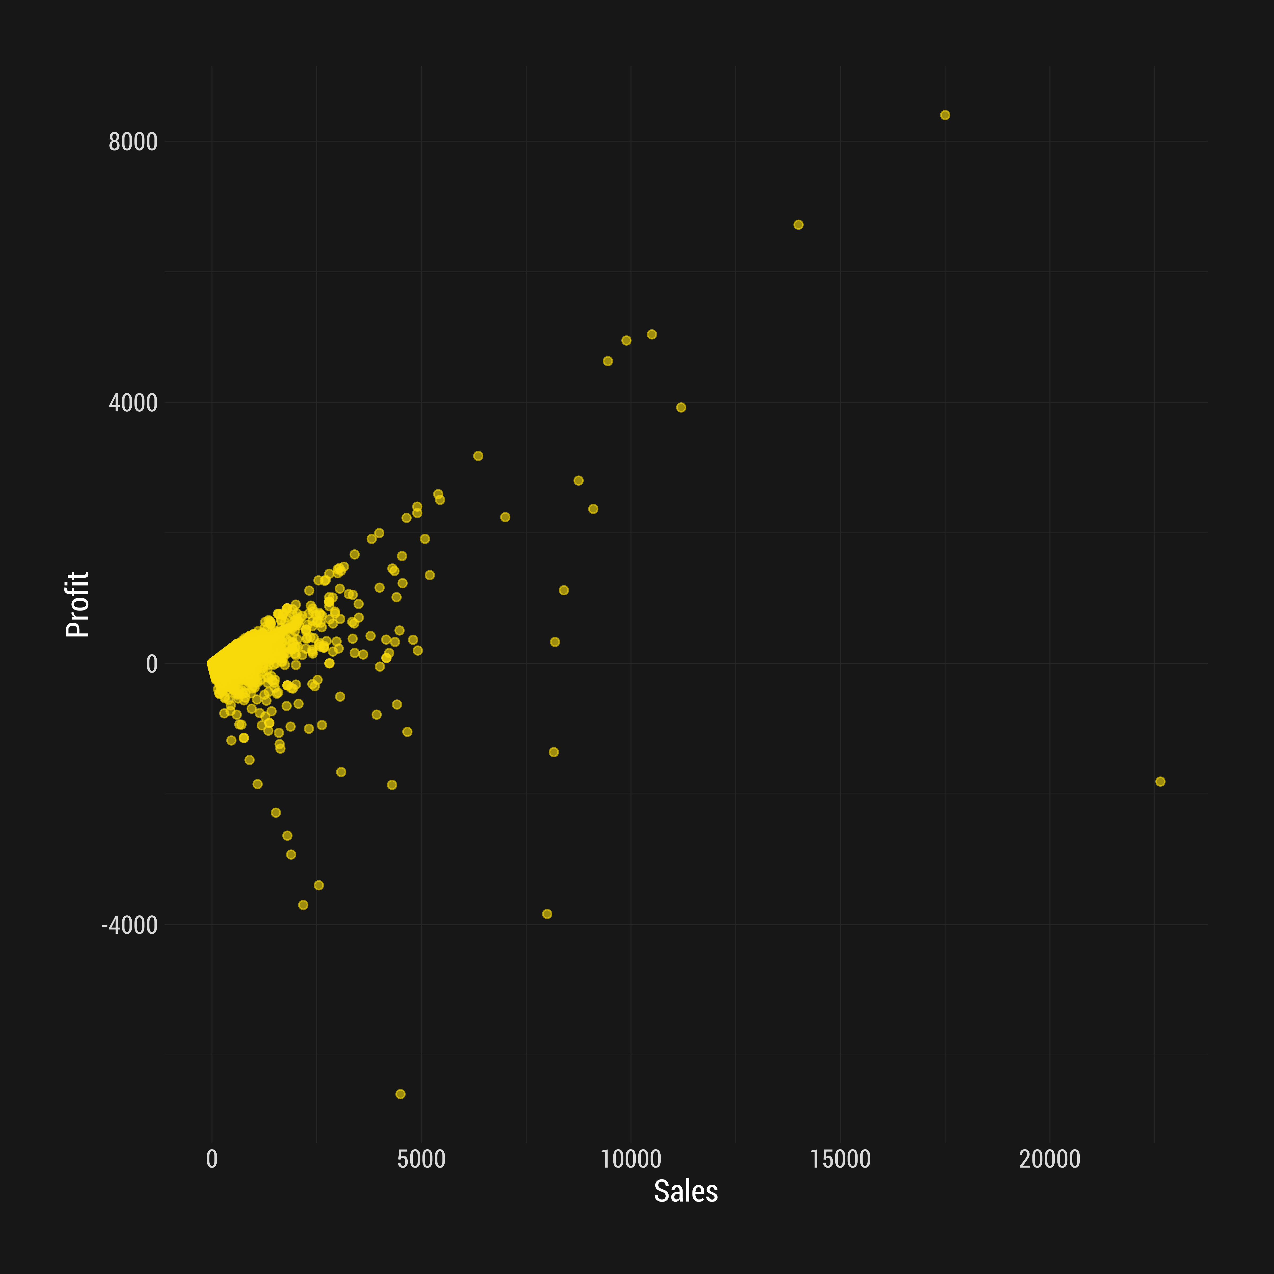
Scatterplot of Profit Vs Sales

